Slide 1
Social Media Platforms and Privacy Controls Sara H. Jodka, Esq.

Slide 4
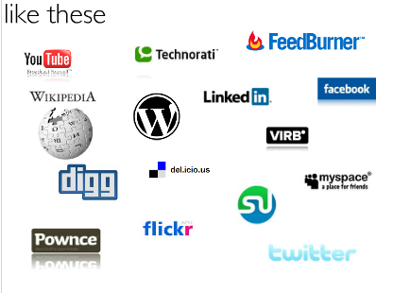

Slide 6
Top 10 Most Popular Social Networking Sites
Source: http://www.ebizmba.com/articles/social-networking-websites

Slide 7
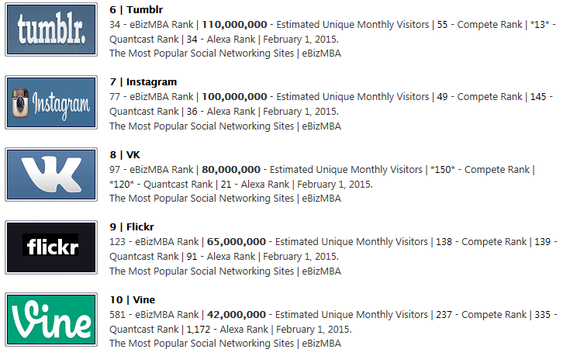
Top 10 Most Popular Social Networking Sites
Source: http://www.ebizmba.com/articles/social-networking-websites

Slide 8
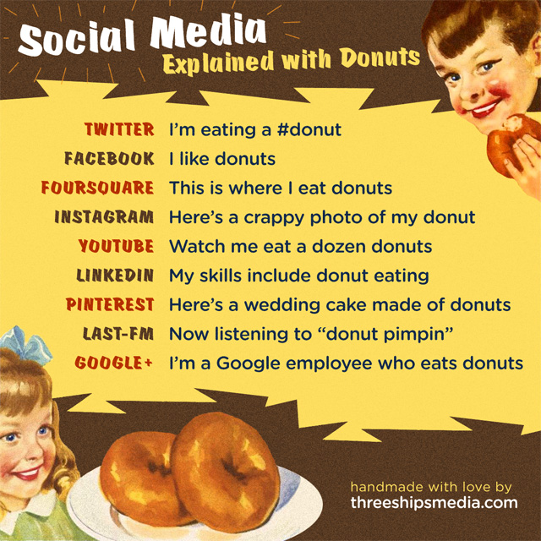

Slide 9
What We Are Going to Dive Into

Slide 11
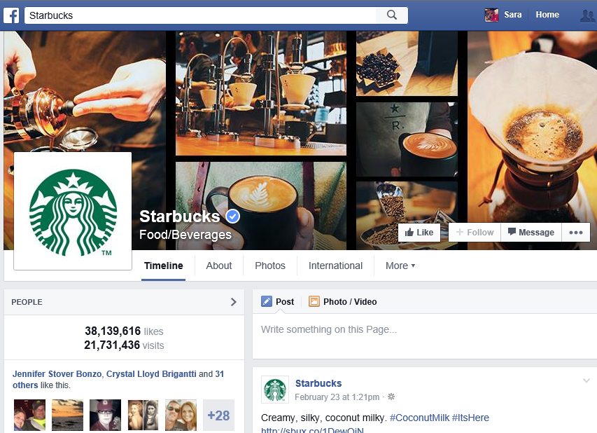
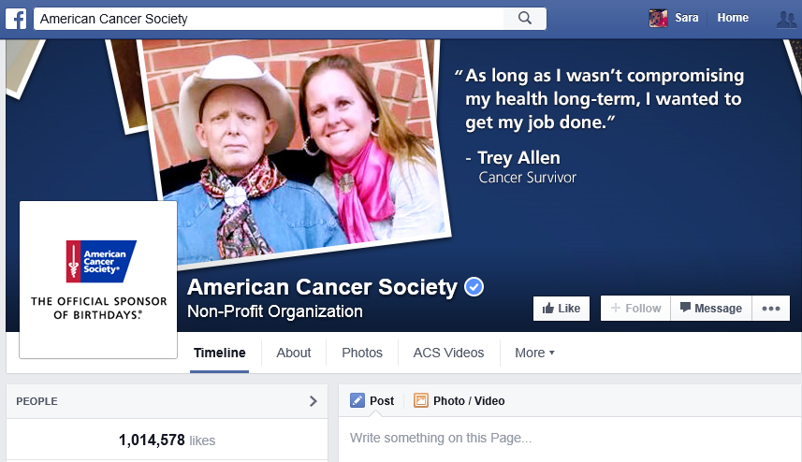
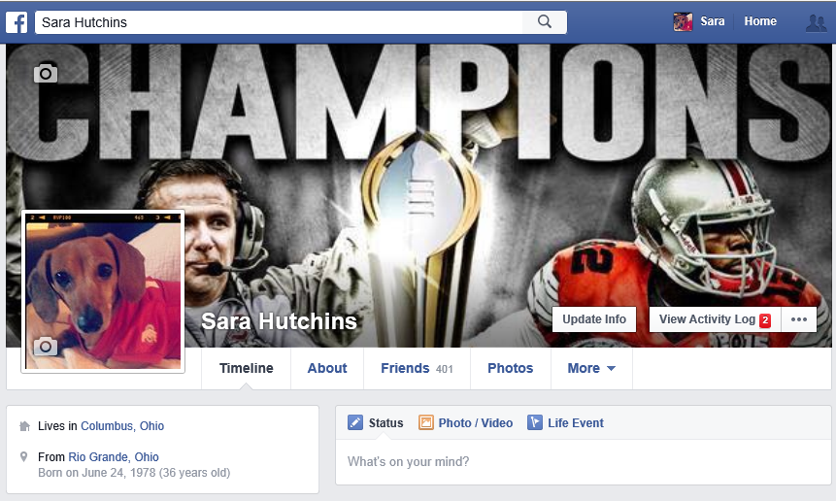
Who Has Facebook Profiles/Pages?

Slide 12
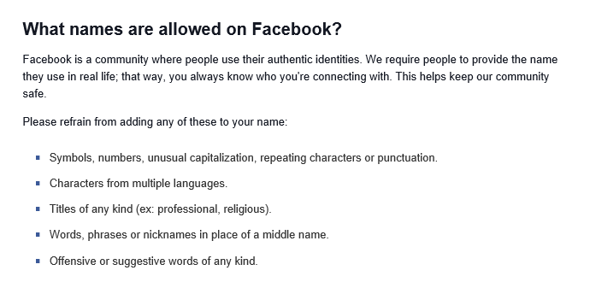
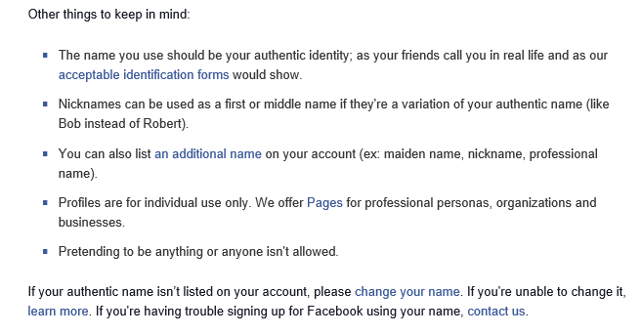
Types of Profile Names Allowed?

Slide 13
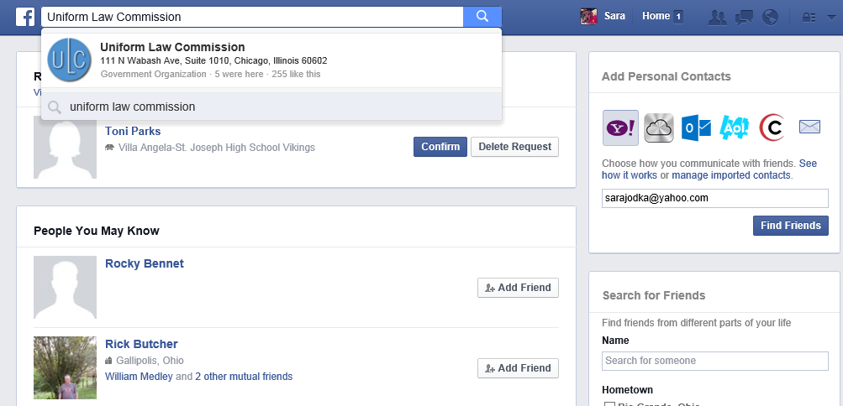
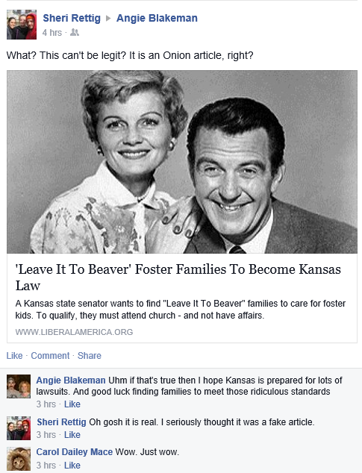
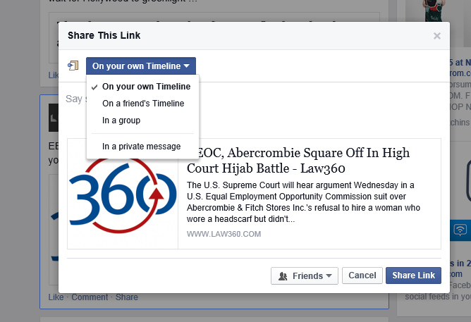
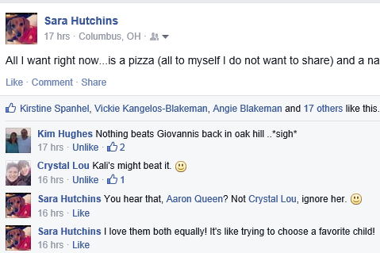
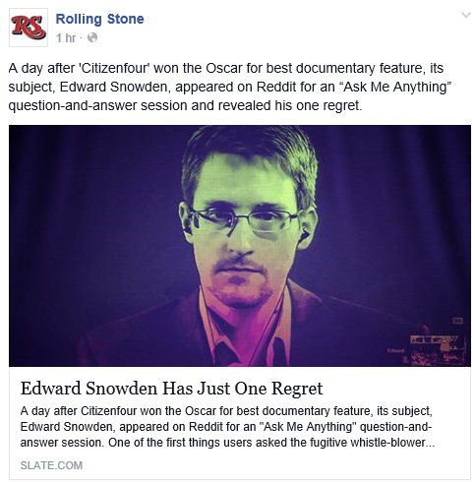
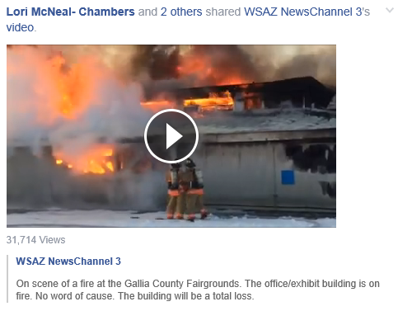
What Are They Doing?

Slide 14
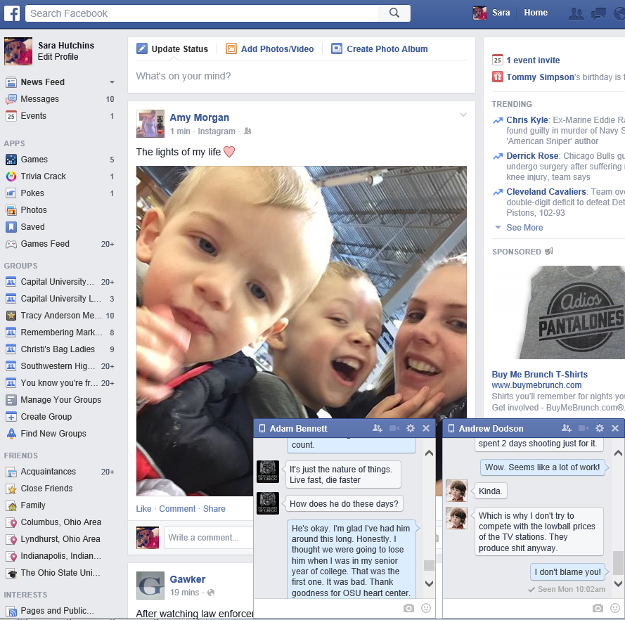
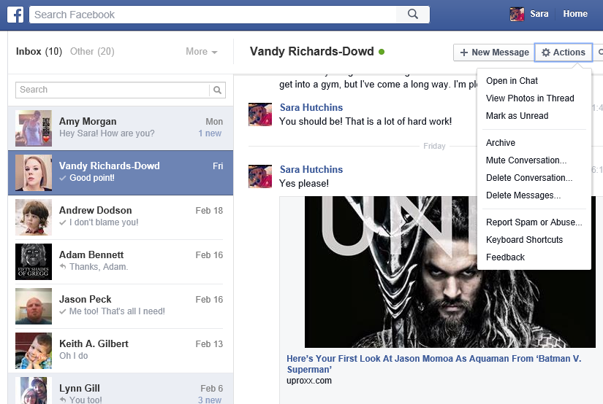
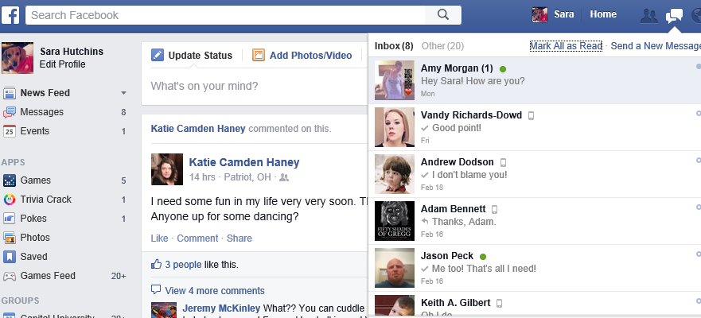
How Are They Doing?

Slide 15
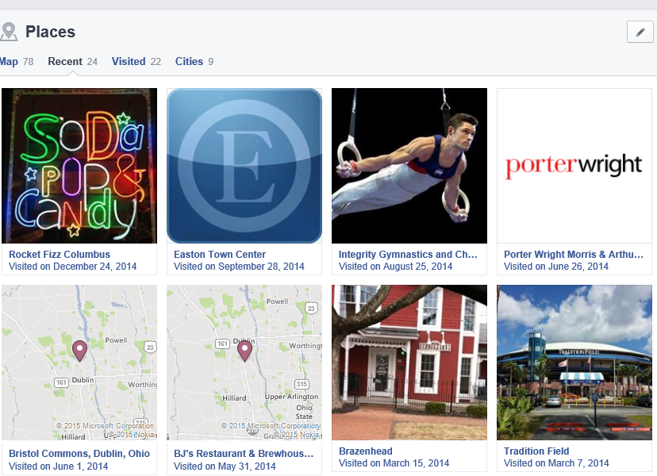
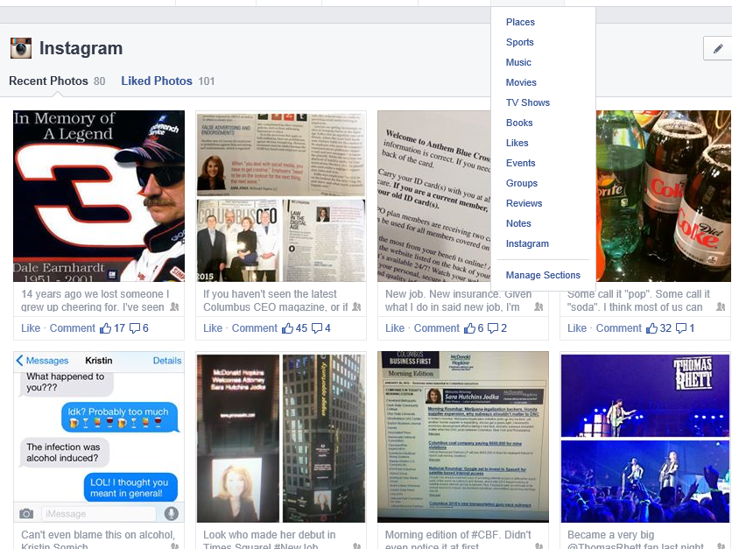
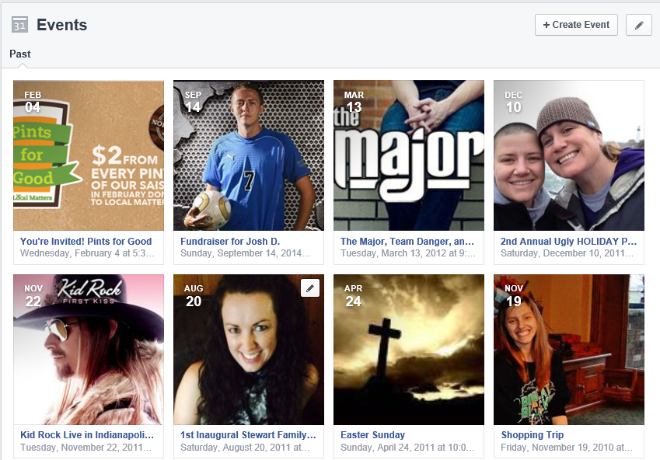
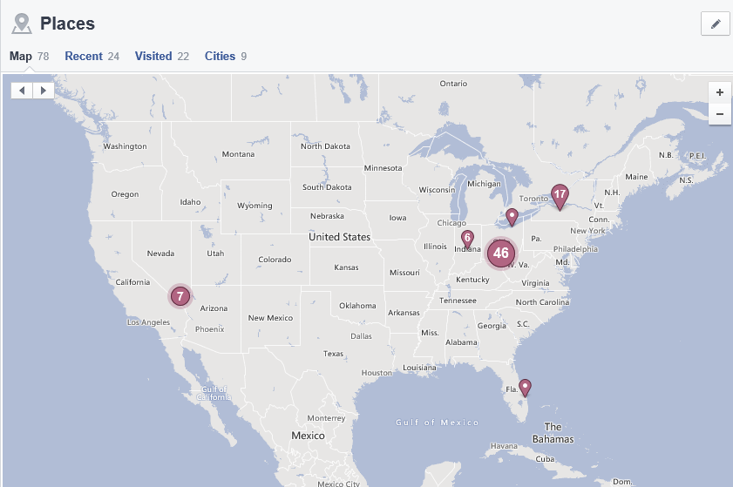
Facebook – A Treasure Trove of Information

Slide 16
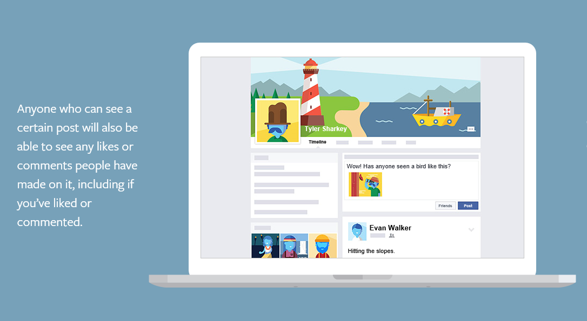
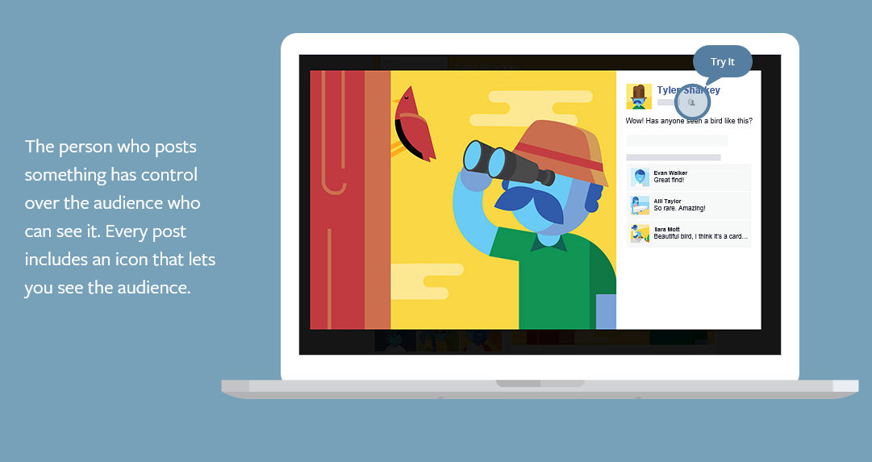
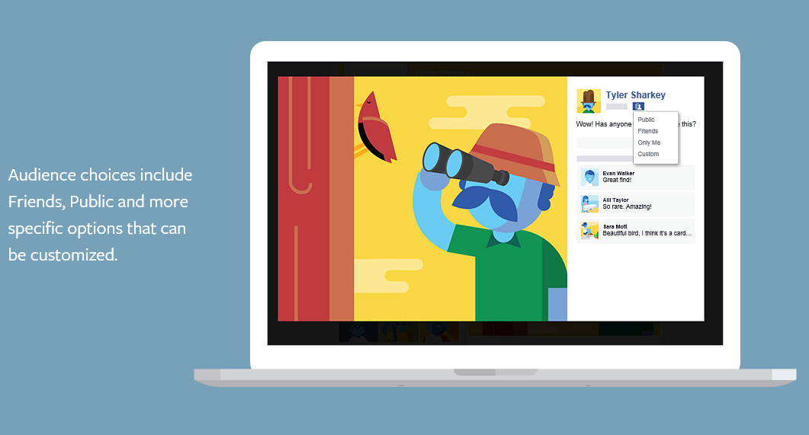
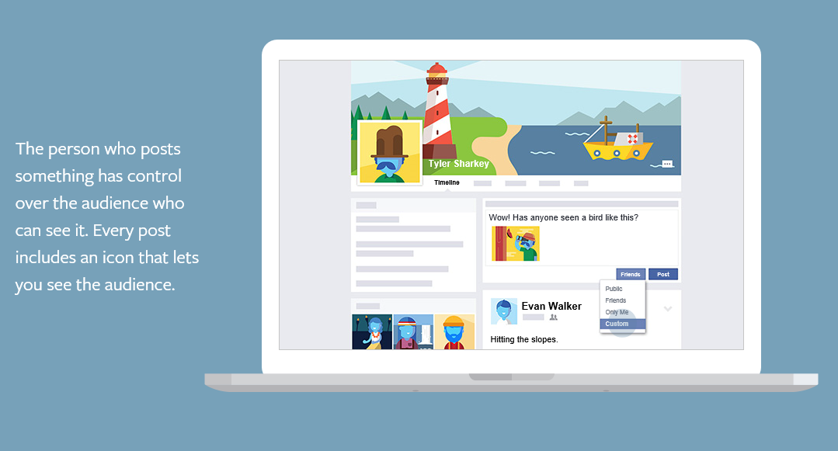
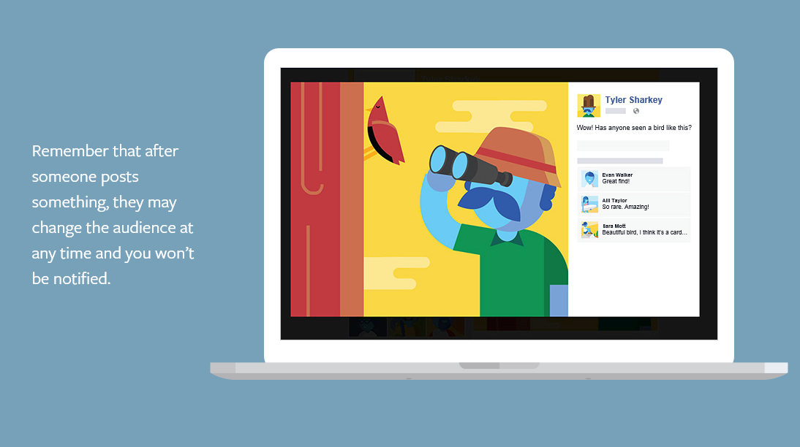
Who Sees What You Post on Other Profiles/Pages

Slide 17
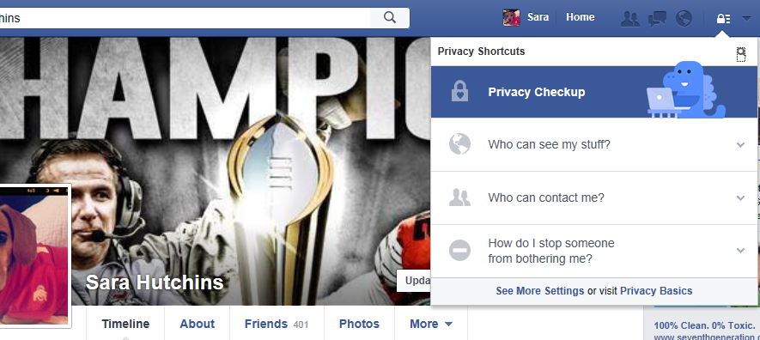

Slide 18
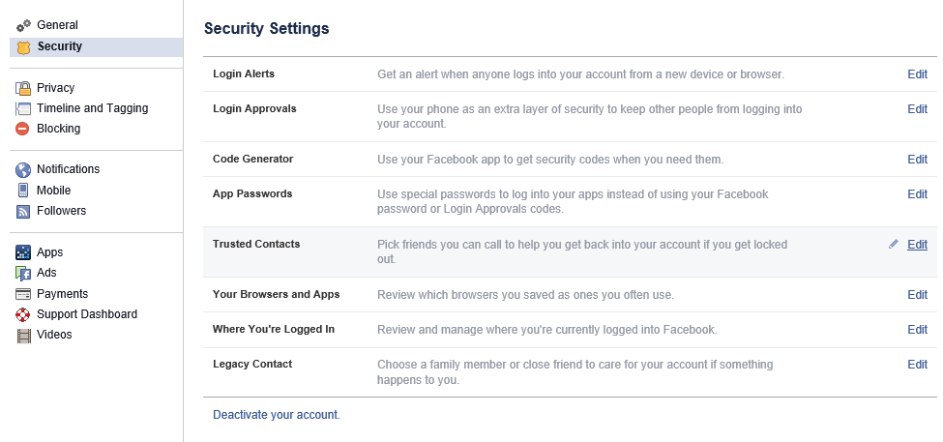

Slide 19
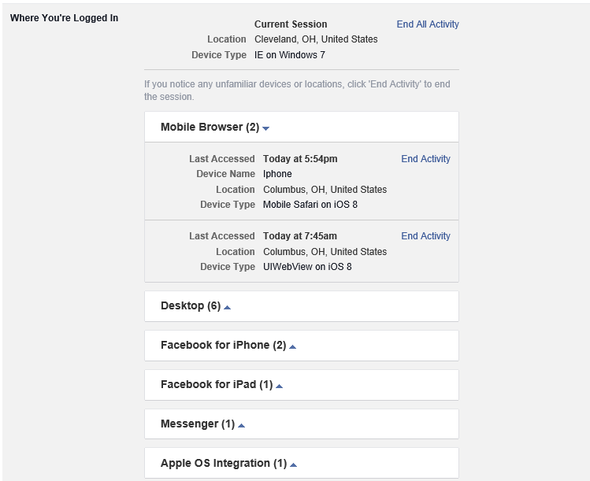

Slide 20
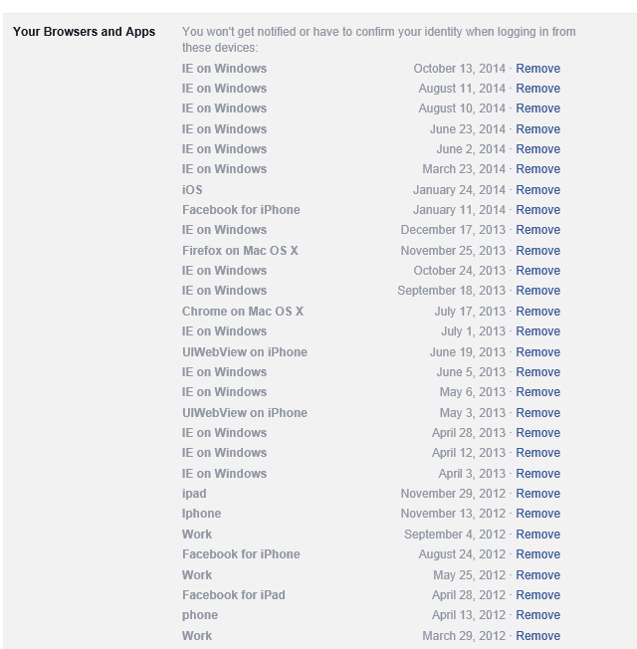

Slide 21
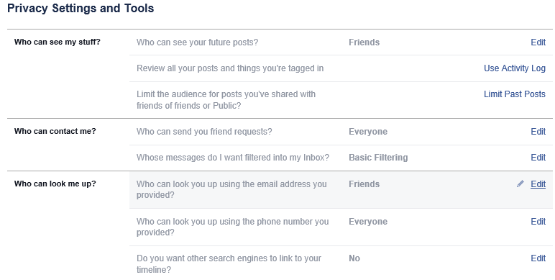
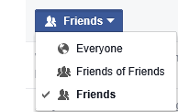

Slide 22
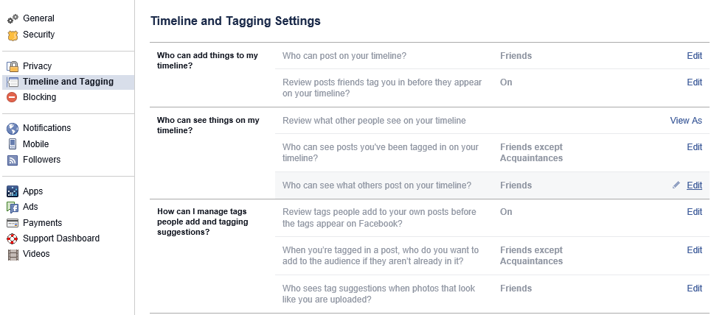

Slide 23
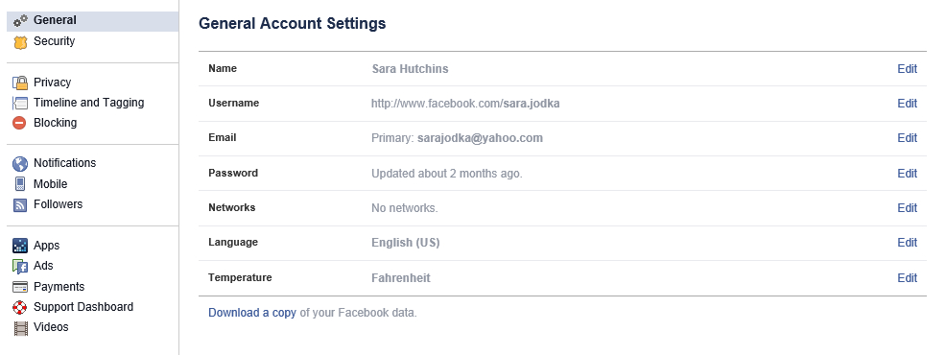

Slide 24
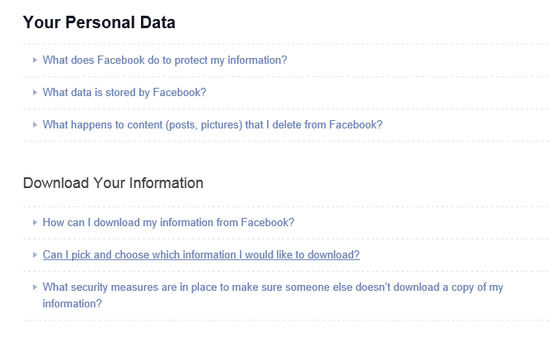

Slide 25
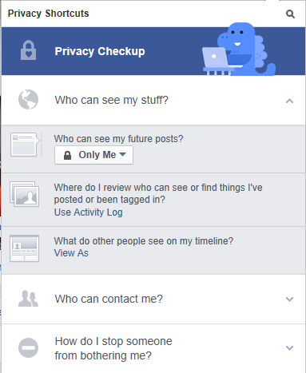
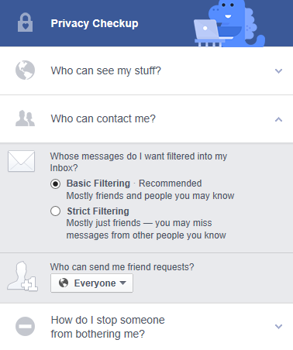
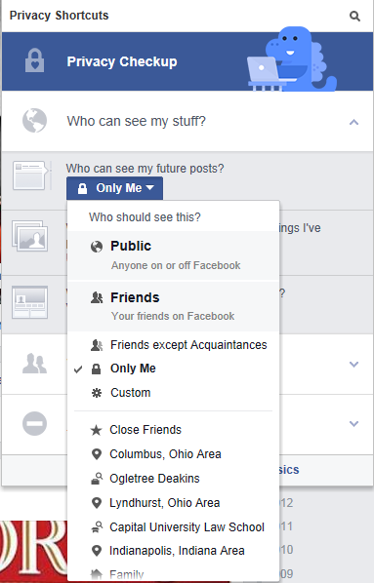
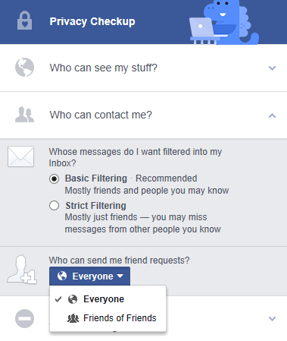
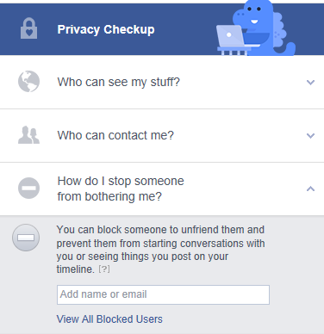

Slide 26
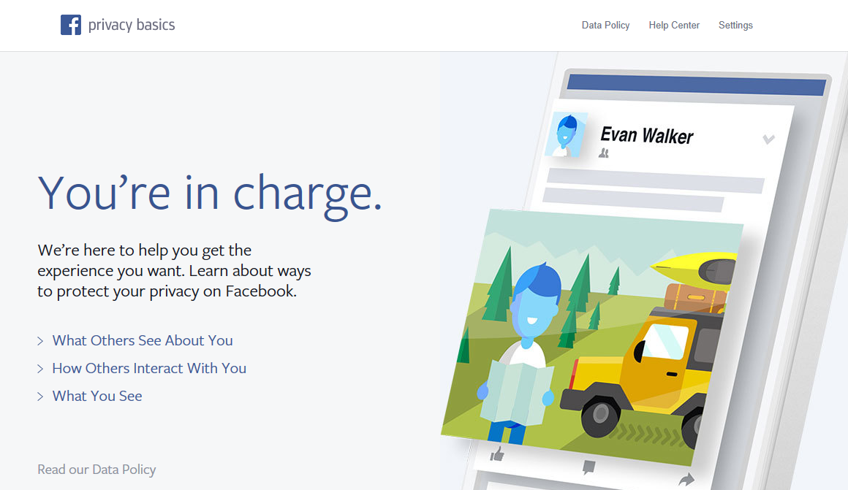
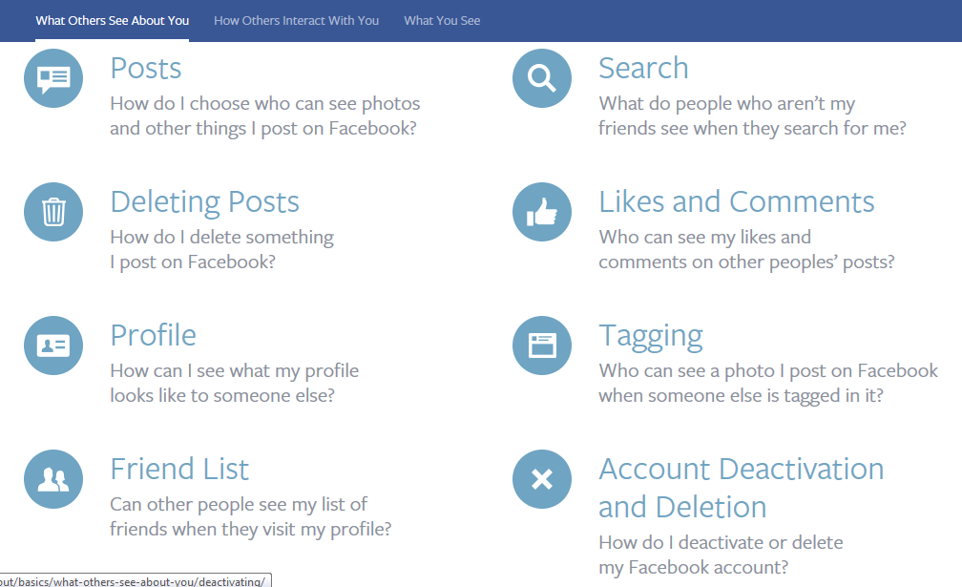

Slide 27
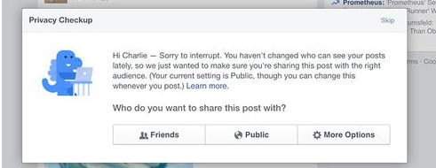
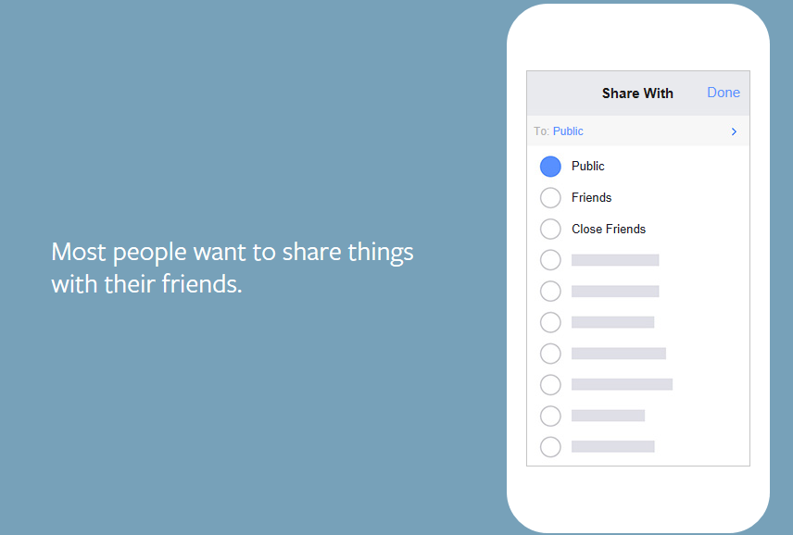
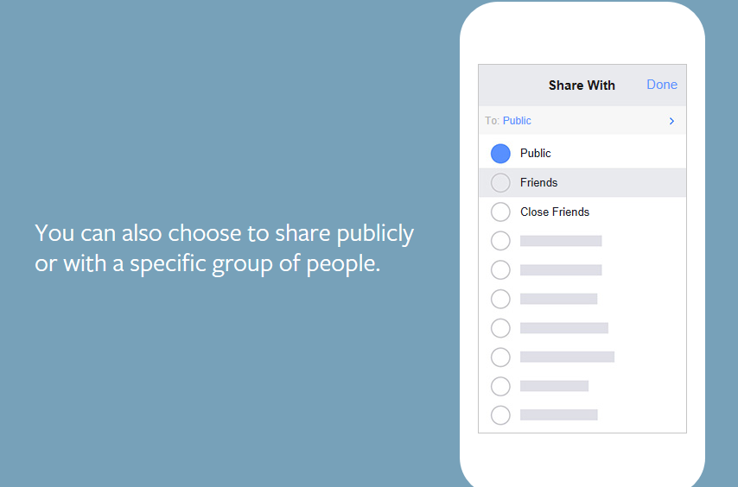
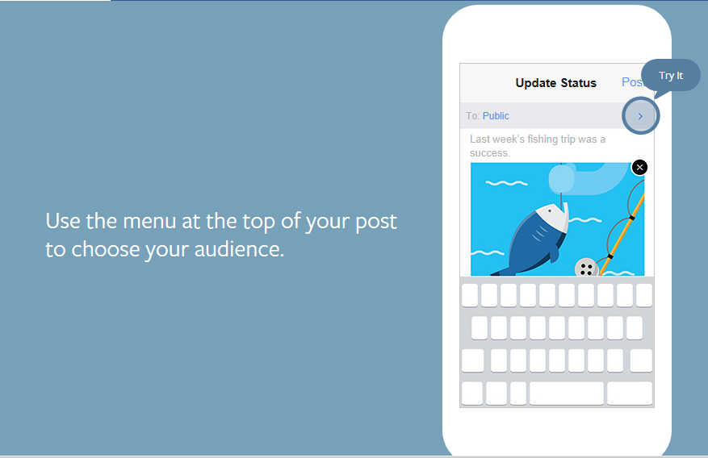
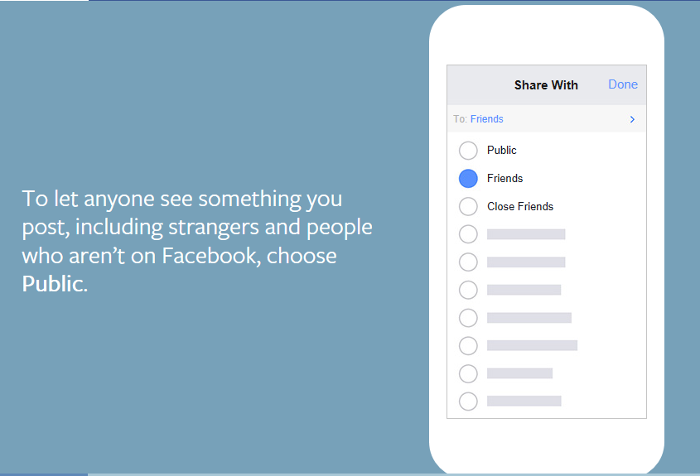
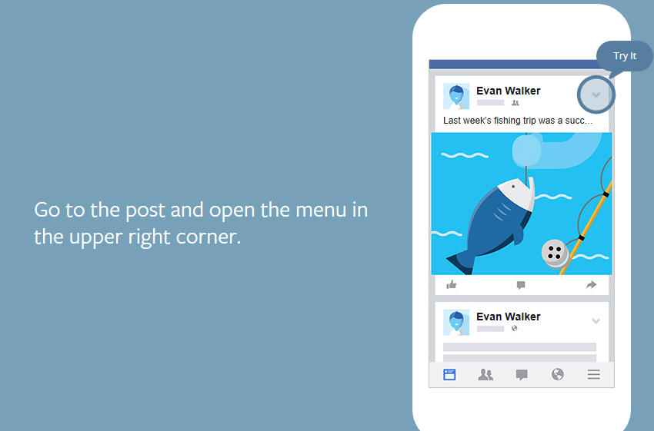
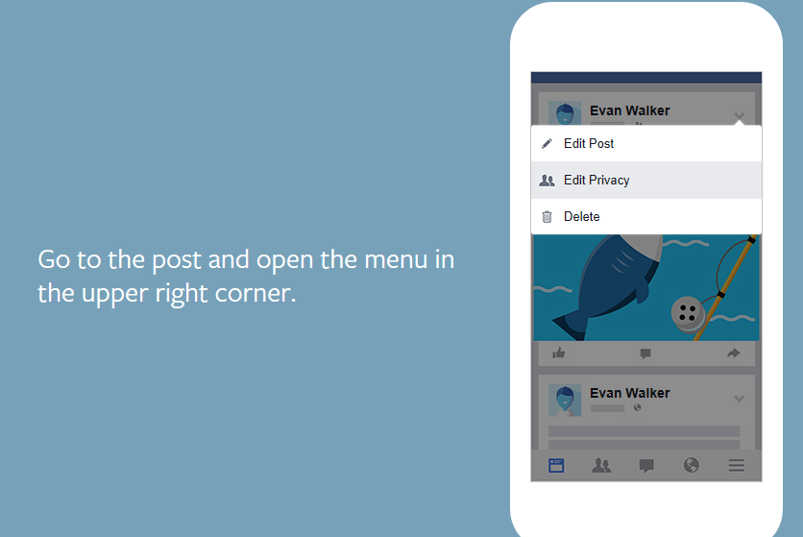
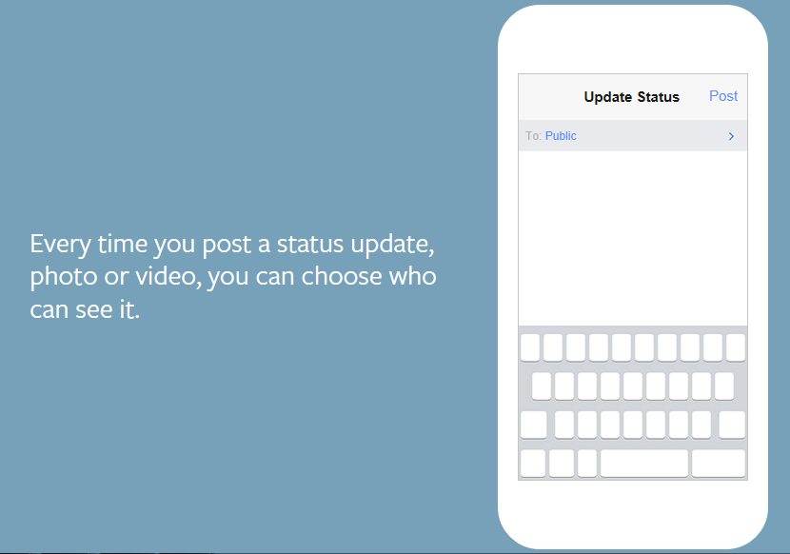
POSTS

Slide 28
POSTS ON A DESKTOP

Slide 29
POST MANIPULATION

Slide 30
Content Hiding and Deletion

Slide 31
Content Extraction

Slide 32
Content Extraction – Download Your Data

Slide 33
Content Extraction – Activity Log

Slide 36
Source: http://statisticbrain.com/twitter-statistics/

Slide 37
Who Has Twitter Pages?

Slide 39
What Are They Doing?

Slide 40
How Are They Doing It?

Slide 41
The Retweet: Proceed with Caution

Slide 42
Privacy

Slide 43
Content Extraction

Slide 44
Instagram

Slide 45
Instagram

Slide 48
Disappearing Message Apps

Slide 49
Snapchat

Slide 50
Snapchat
Founded because one of the founders sent a friend a picture and regretted it.
Users can take photos, record videos add text and drawings, and send them to a controlled list of recipients. These are called “SNAPS” .
Users set a time limit – usually seconds – for how recipients can view their SNAPS, after which they will be hidden from the recipient’s device. They are then allegedly deleted from Snapchat servers.

Slide 51
Questions
Sara H. Jodka
T: 614.484.0716
C: 216.346.7592
sjodka@mcdonaldhopkins.com
Twitter: @sarajodka

